Slide 1
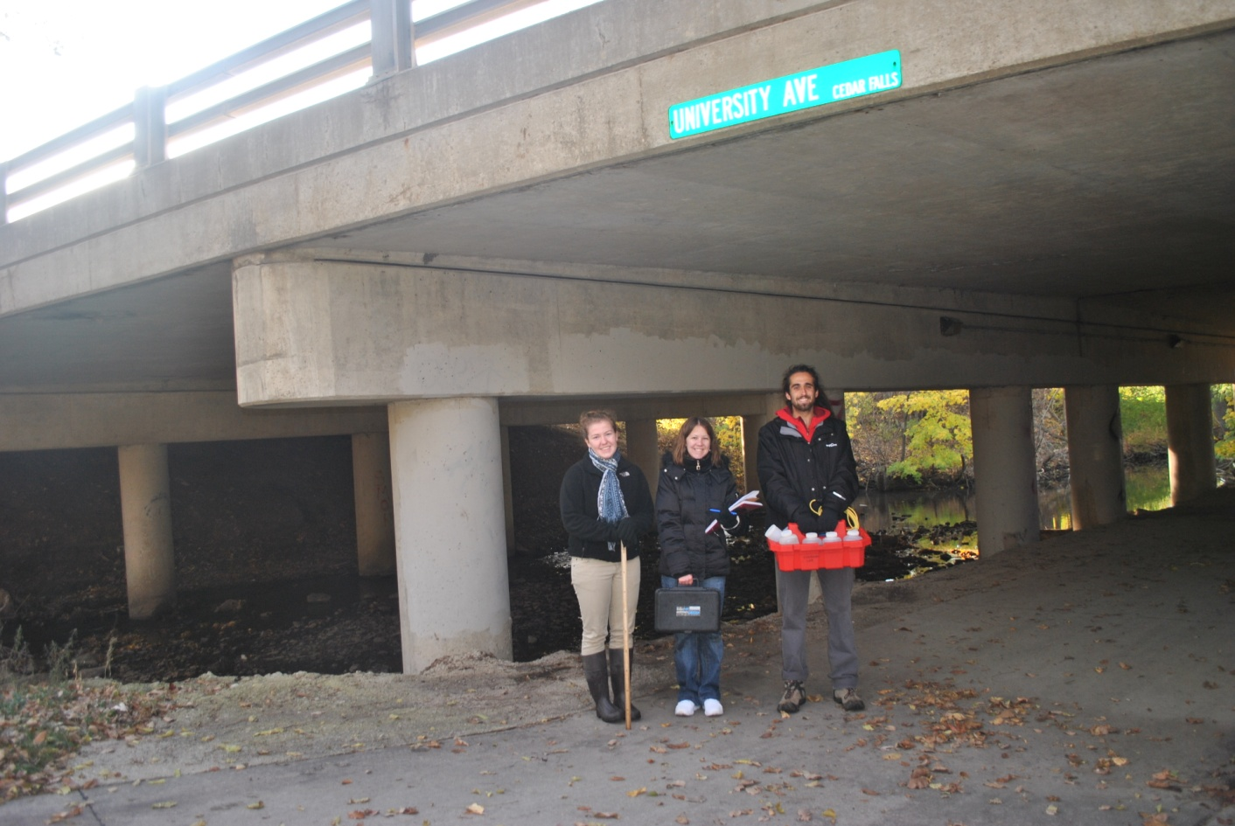
The Effects of an Overpass
on a Stream

Slide 2
Purpose
To determine how a manmade structure, an overpass, effects aspects of stream water quality and discharge.

Slide 3
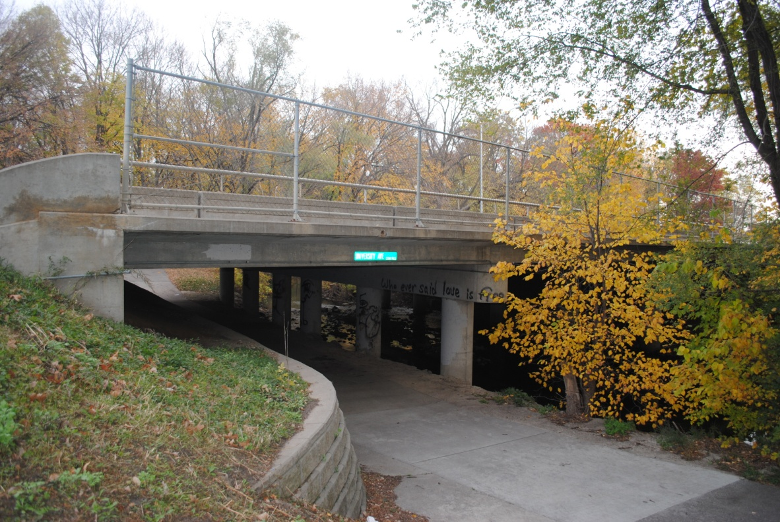
Location

Slide 4
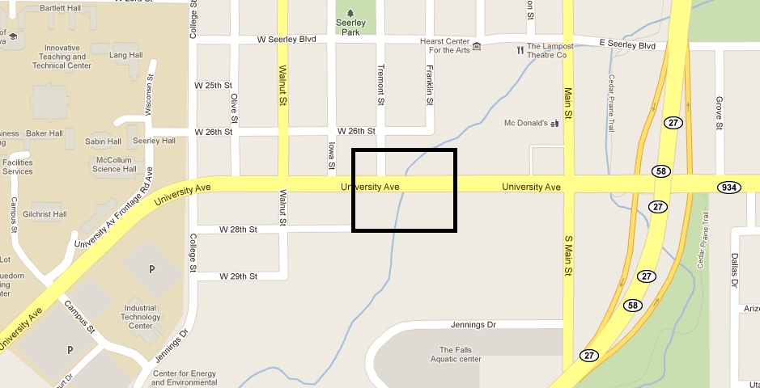

Slide 5
Upstream

Slide 6
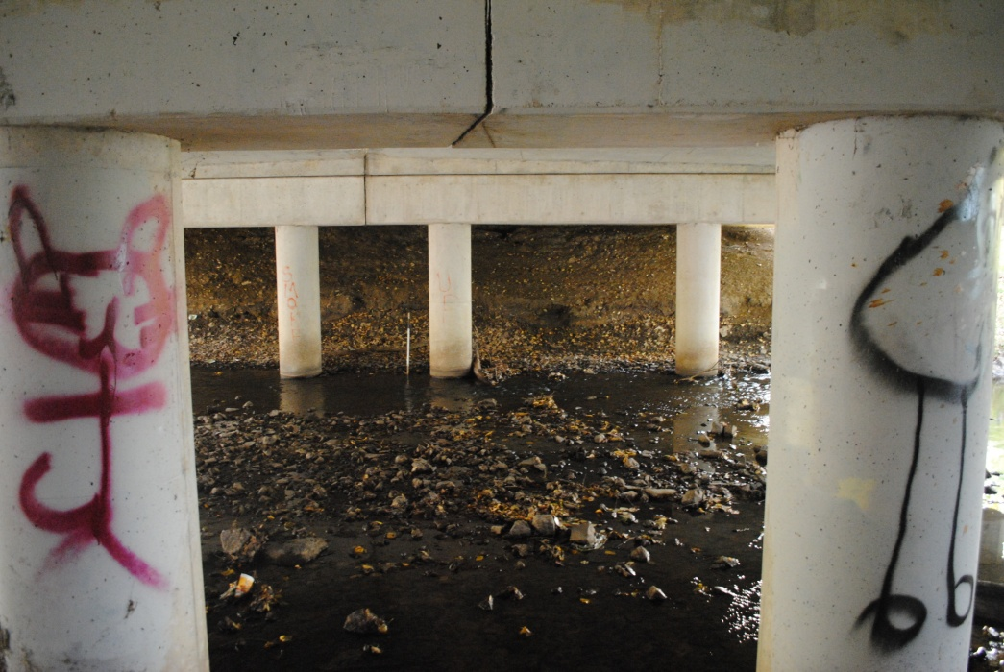
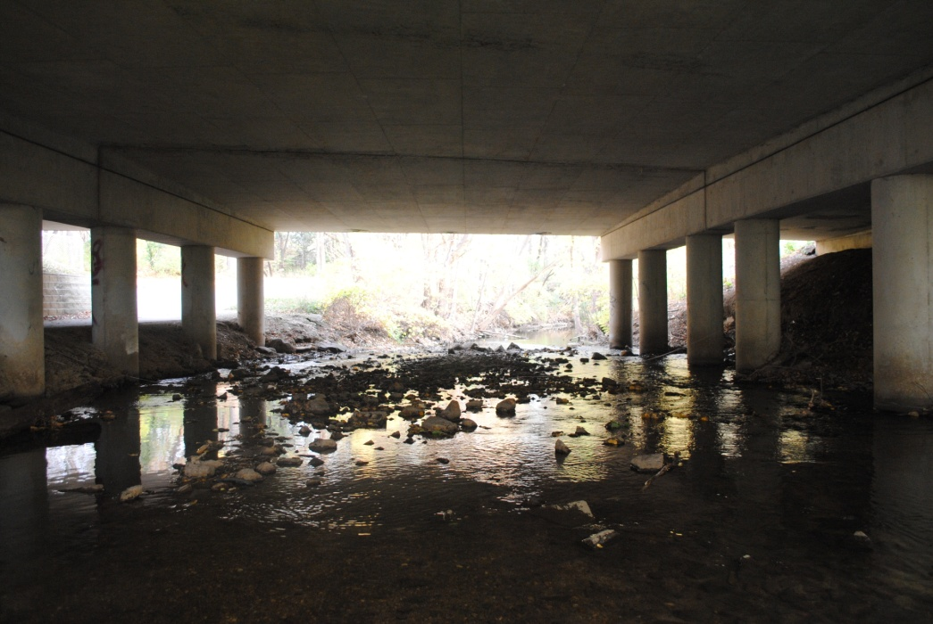
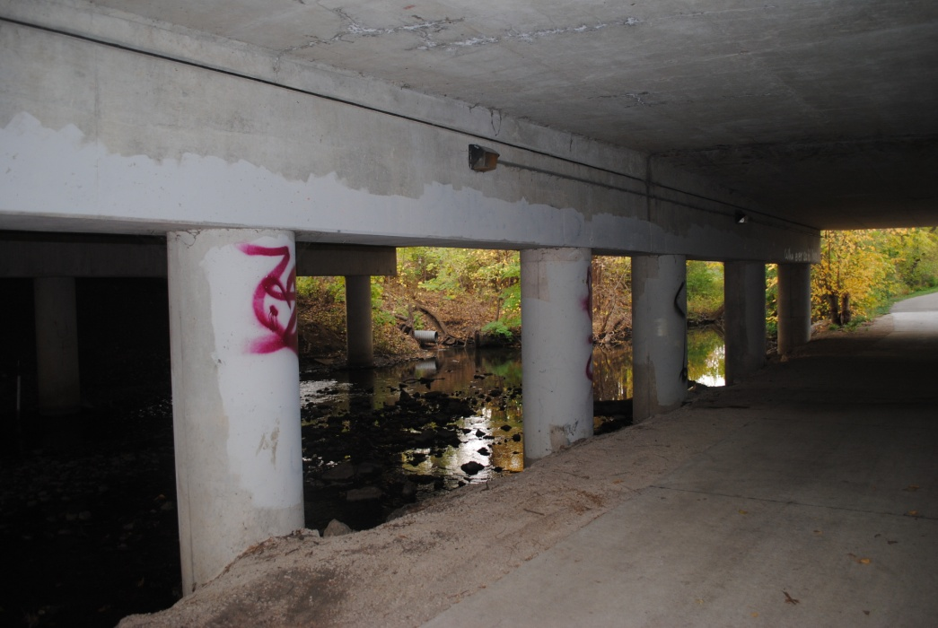
Under

Slide 7
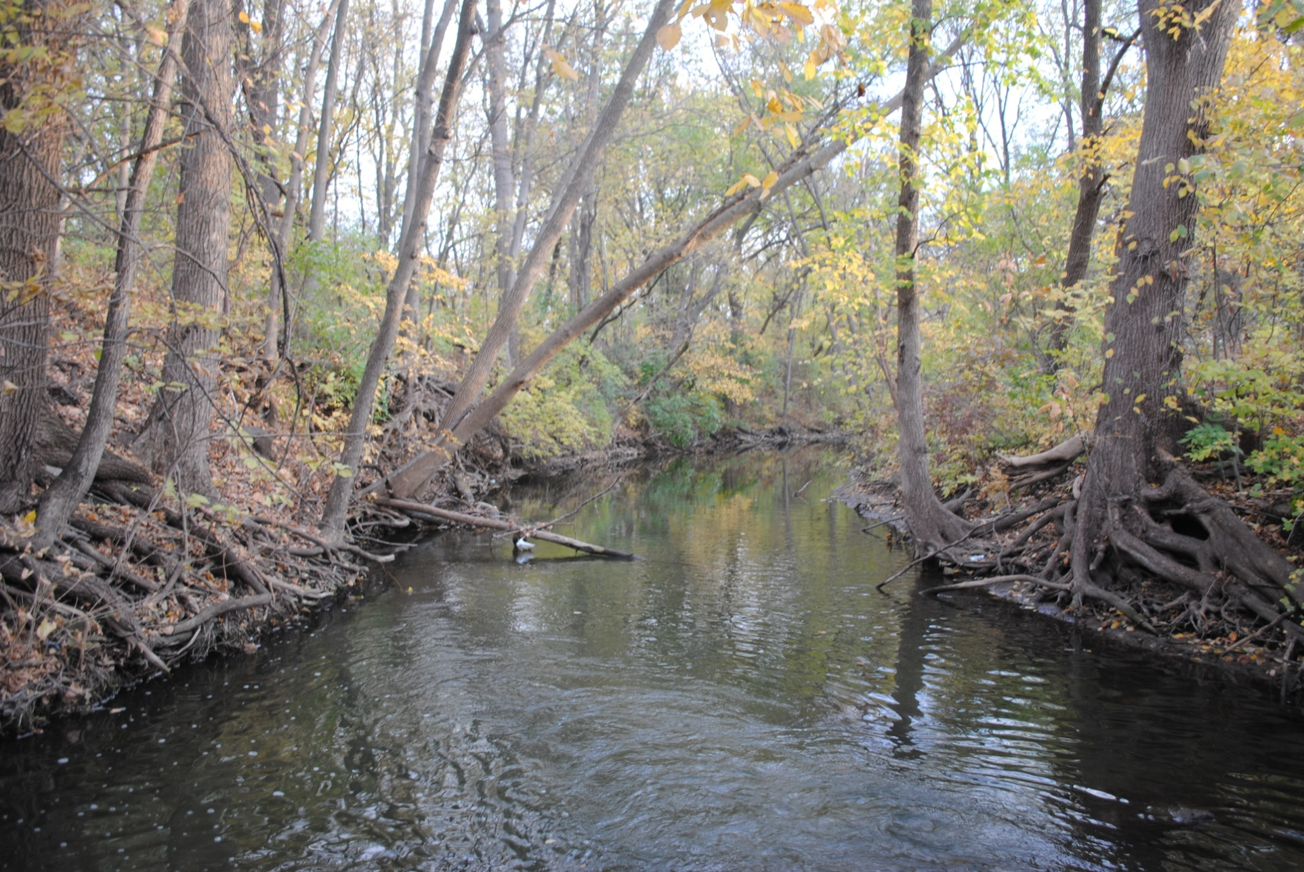
Downstream

Slide 8
Testing Methods
Velocity Discharge
Turbidity Chloride
Temperature pH
Total Dissolved Solids
Dissolved Oxygen
Total Suspended Solids

Slide 9
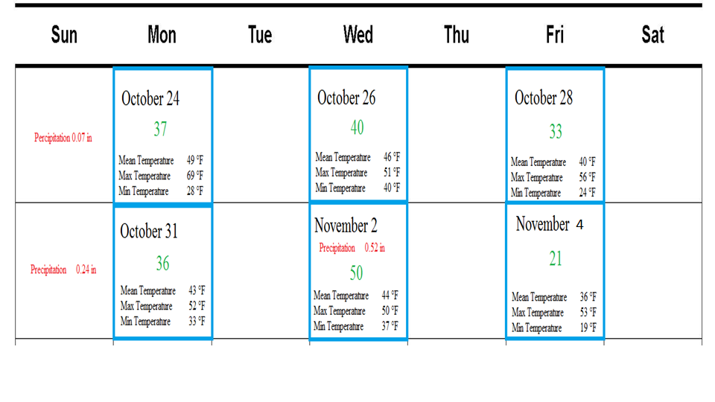
Testing Dates

Slide 10
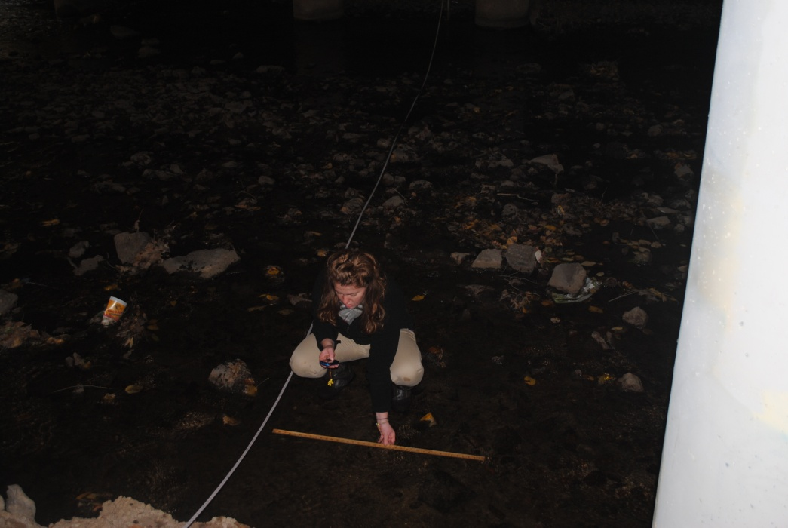
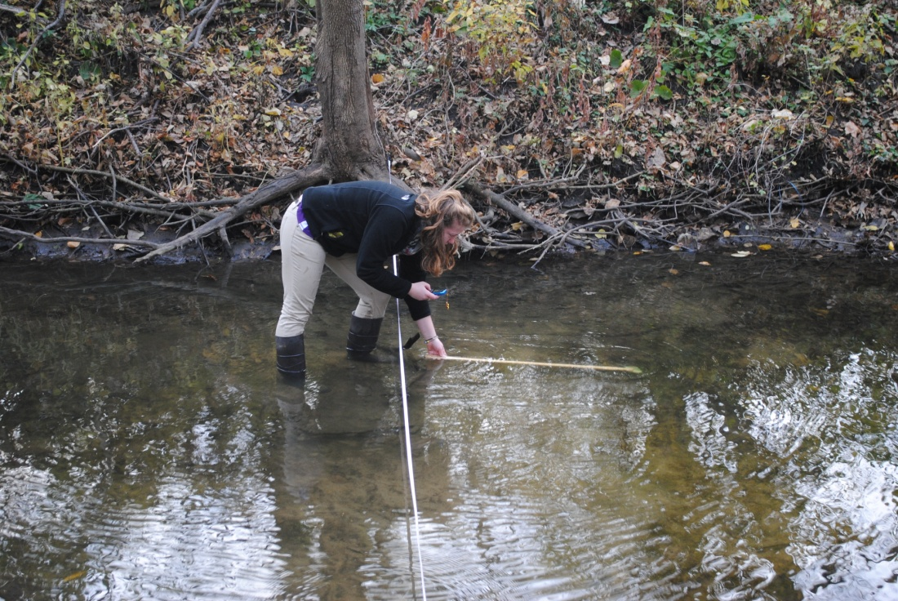
Velocity

Slide 11
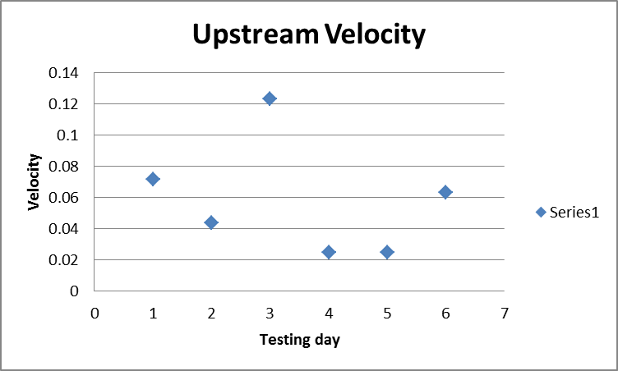
Upstream Velocity
0.071808 m/s
0.043882 m/s
0.123226 m/s
0.024628 m/s
0.024912 m/s
0.063357 m/s
Average 0.058636 m/s

Slide 12
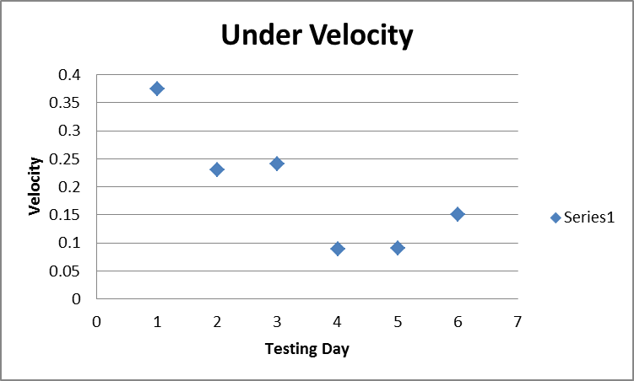
Under Velocity
0.374803 m/s
0.230076 m/s
0.240983 m/s
0.088675 m/s
0.089918 m/s
0.151154 m/s
Average 0.195935 m/s

Slide 13
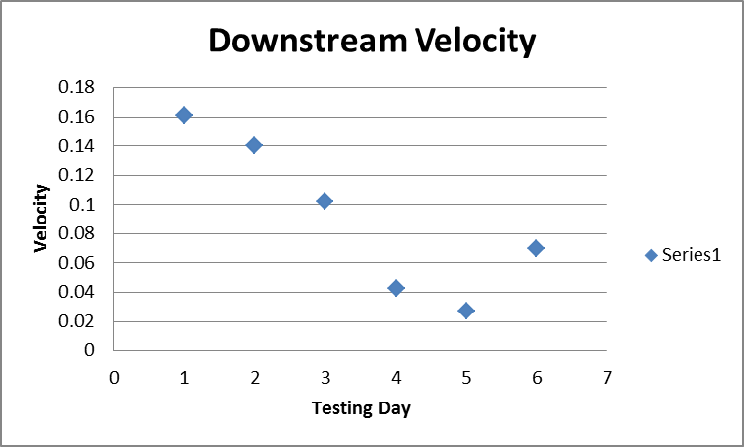
Downstream Velocity
0.161196 m/s
0.140496 m/s
0.102525 m/s
0.042746 m/s
0.027365 m/s
0.069679 m/s
Average 0.09067 m/s

Slide 14
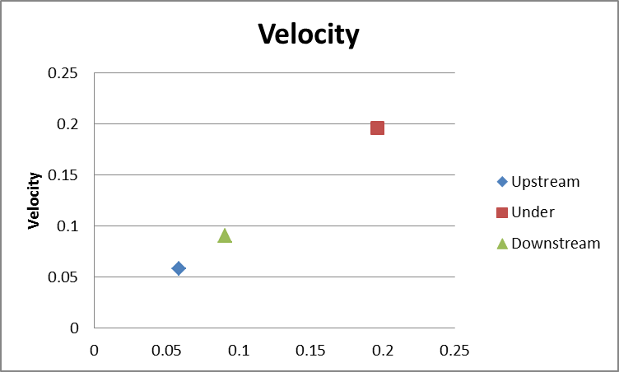
Site Comparison

Slide 15
Discharge

Slide 16
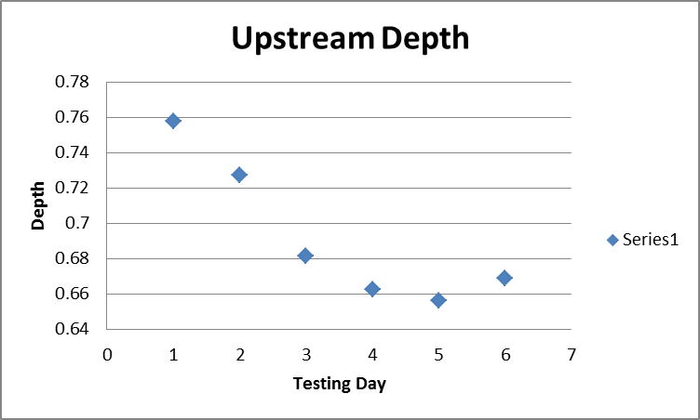

Slide 17
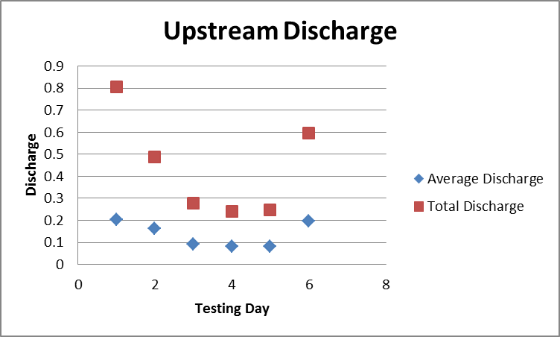
Upstream Discharge
Average Discharge
0.20373 m³/s
0.16297 m³/s
0.09243 m³/s
0.080629 m³/s
0.082795 m³/s
0.19825 m³/s
Average 0.136801 m³/s
Total Discharge
0.8073 m³/s
0.4889 m³/s
0.2773 m³/s
0.2419 m³/s
0.2484 m³/s
0.5948 m³/s
Average 0.4431 m³/s

Slide 18
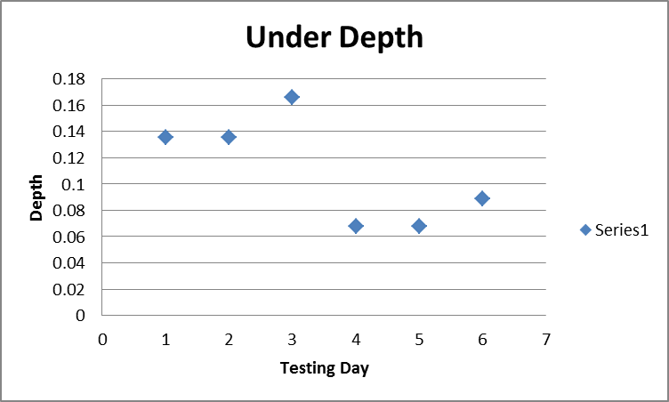

Slide 19
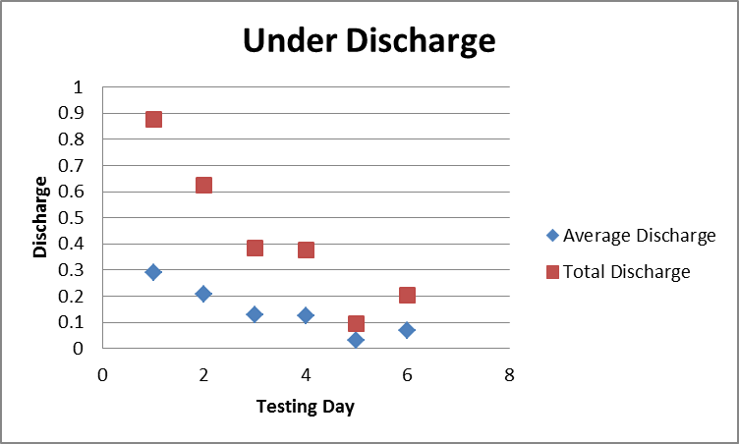
Under Overpass Discharge
Total Discharge
0.8753 m³/s
0.6259 m³/s
0.3826 m³/s
0.3749 m³/s
0.0957 m³/s
0.2043 m³/s
Average .42645m³/s
Average Discharge
0.291762 m³/s
0.208635 m³/s
0.127529 m³/s
0.124951 m³/s
0.031915 m³/s
0.068111 m³/s
Average 0.14215 m³/s

Slide 20
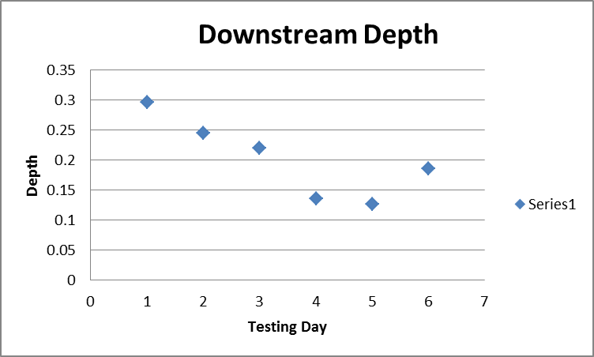

Slide 21
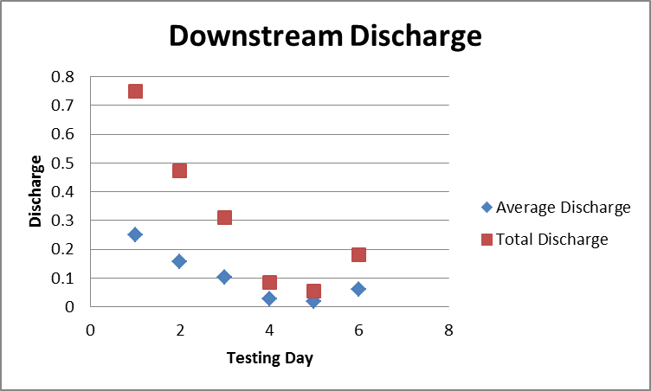
Downstream Discharge
Total Discharge
0.7504 m³/s
0.4727 m³/s
0.3112 m³/s
0.0844 m³/s
0.054 m³/s
0.1808 m³/s
Average 0.30892m³/s
Average Discharge
0.250148 m³/s
0.157669m³/s
0.103747m³/s
0.028124m³/s
0.018011m³/s
0.060252 m³/s
Average 0.102992m³/s

Slide 22
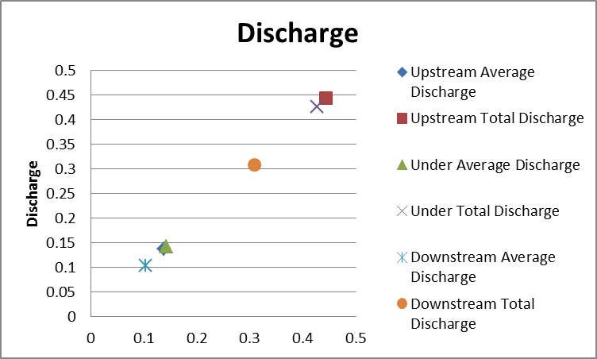
Site Comparison

Slide 23
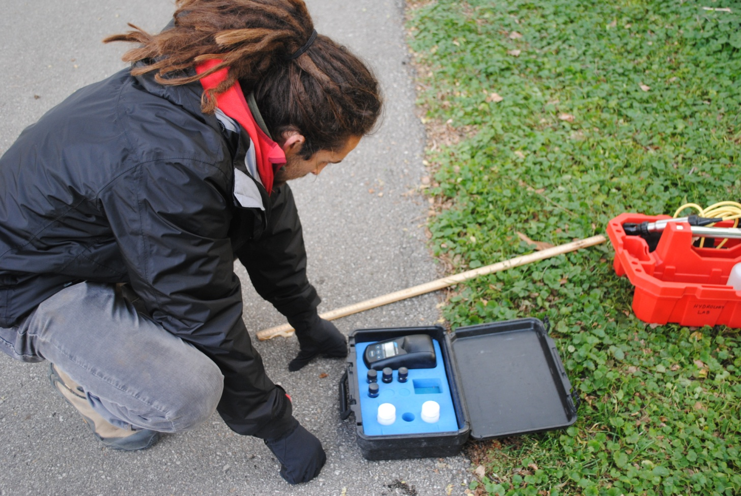
Turbidity

Slide 24
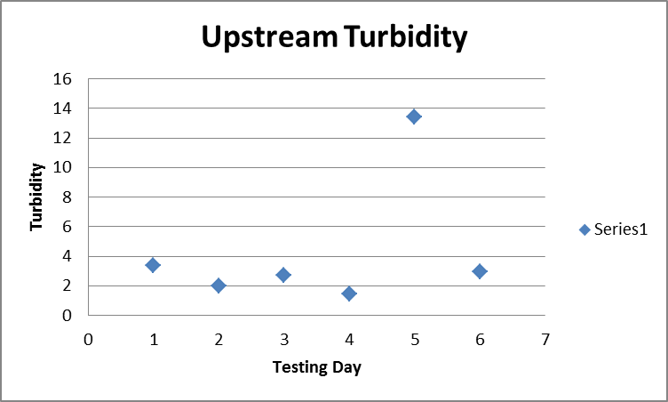
Upstream Turbidity
3.38 NTU
2.02 NTU
2.72 NTU
1.46 NTU
13.4 NTU
2.97 NTU
Average 4.325 NTU

Slide 25
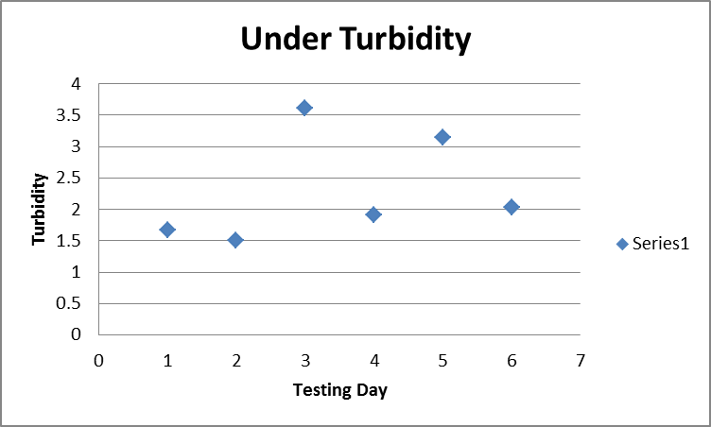
1.67 NTU
1.5 NTU
3.61 NTU
1.91 NTU
3.14 NTU
2.03 NTU
Average 2.31 NTU
Under Overpass Turbidity

Slide 26
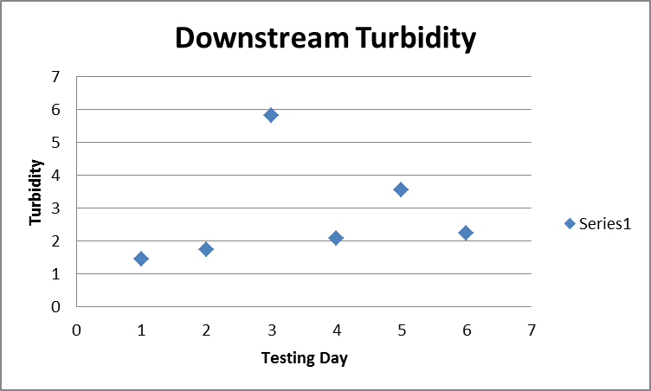
Downstream Turbidity
1.45 NTU
1.75 NTU
5.83 NTU
2.08 NTU
3.55 NTU
2.24 NTU
Average 2.816667 NTU

Slide 27
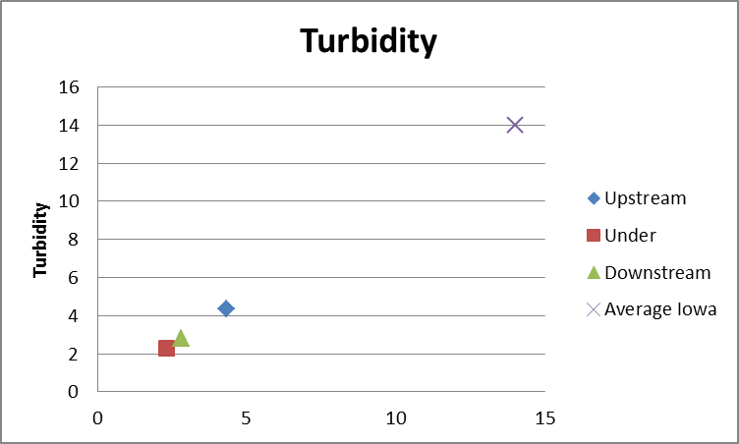
Site Comparison
Average
Upstream 4.325 NTU
Under 2.31 NTU
Downstream 2.816666667 NTU
Average Iowa 14 NTU

Slide 28
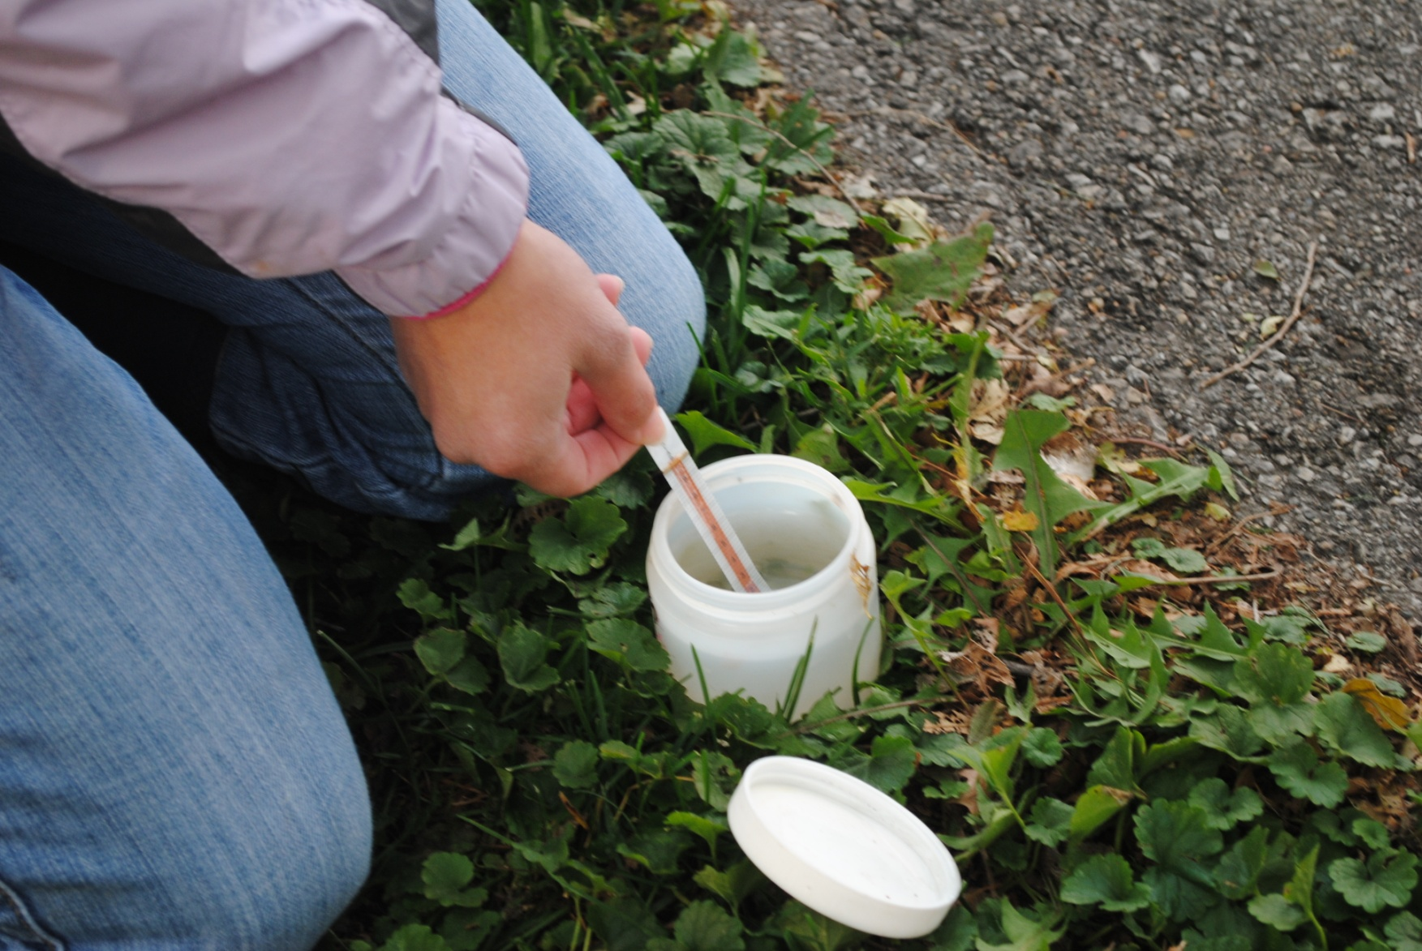
Chloride

Slide 29
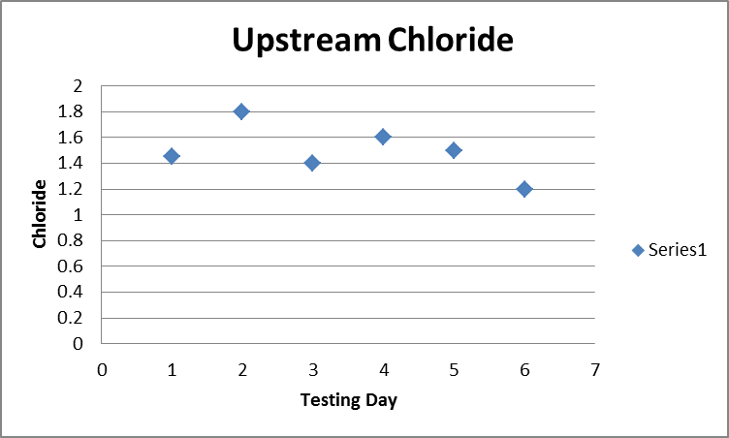
1.45
1.8
1.4
1.6
1.5
1.2
Average 1.491667
Average 36 ppm
Upstream Chloride

Slide 30
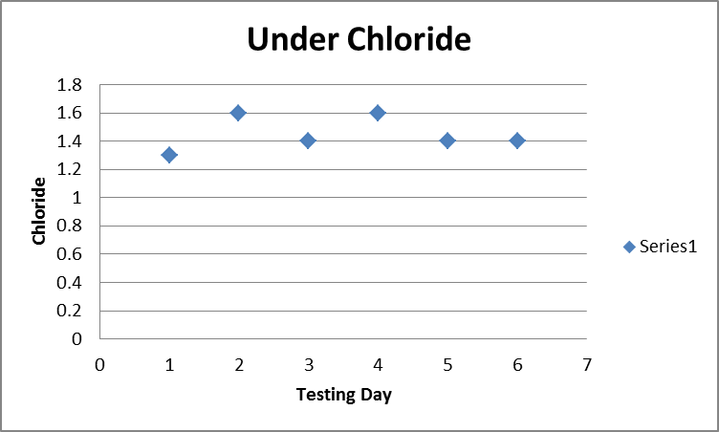
Under Overpass Chloride
1.3
1.6
1.4
1.6
1.4
1.4
Average 1.45
Average 36 ppm

Slide 31
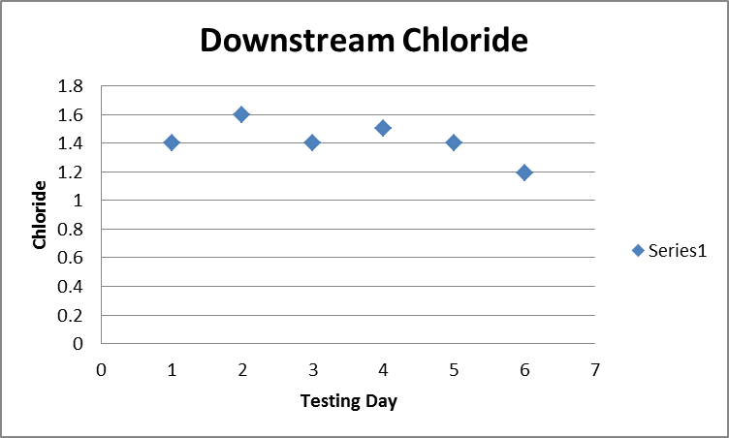
1.4
1.6
1.4
1.5
1.4
1.19
Average 1.415
Average 33 ppm
Downstream Chloride

Slide 32
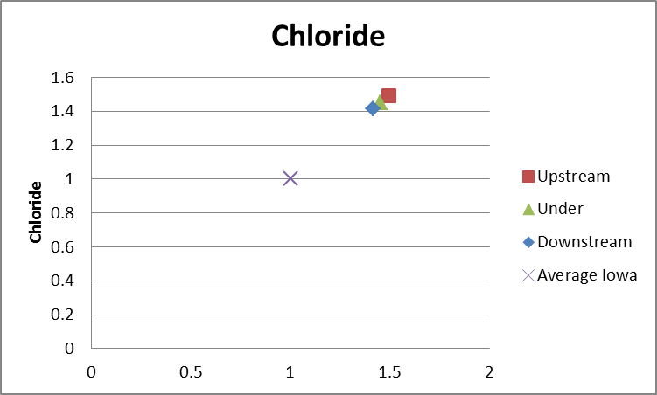
Site Comparisons
Upstream 1.491666667 or 36 ppm
Under 1.45 or 36 ppm
Downstream 1.415 or 33 ppm
Average Iowa 1 or 22 ppm

Slide 33
Temperature

Slide 34
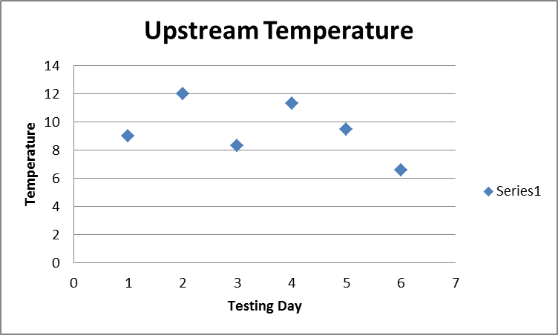
Upstream Temperature
9 °C
12 °C
8.3 °C
11.3 °C
9.5 °C
6.6 °C
Average 9.45 °C

Slide 35
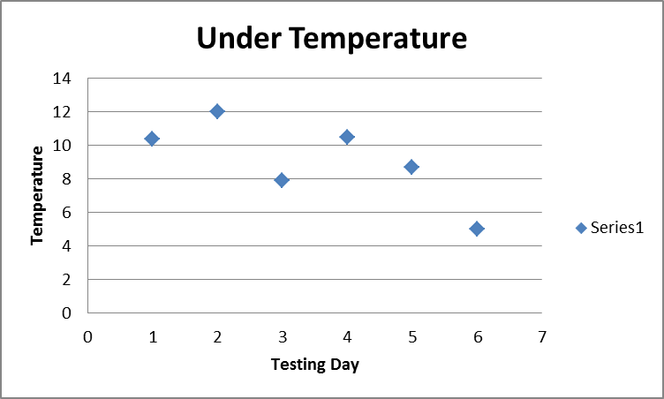
Under Overpass
Temperature
10.4 °C
12 °C
7.9 °C
10.5 °C
8.7 °C
5 °C
Average 9.083333333 °C

Slide 36
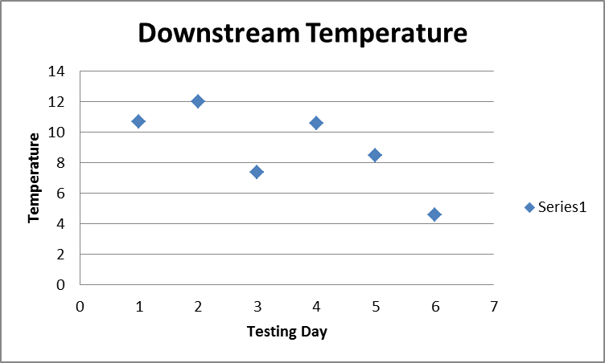
10.7 °C
12 °C
7.4 °C
10.6 °C
8.5 °C
4.6 °C
Average 8.966666667 °C
Downstream Temperature

Slide 37
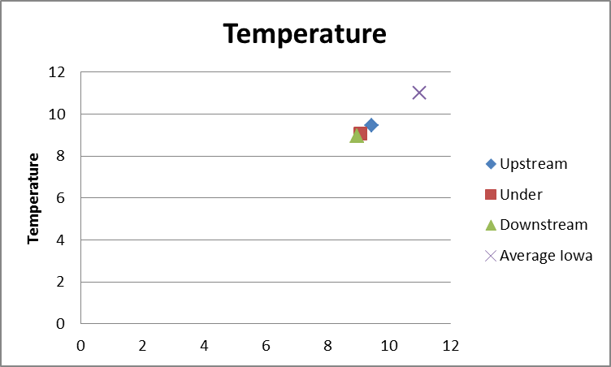
Site Comparison
Upstream 9.45 °C
Under 9.083333333 °C
Downstream 8.966666667 °C
Average Iowa 11 °C

Slide 38
pH

Slide 39
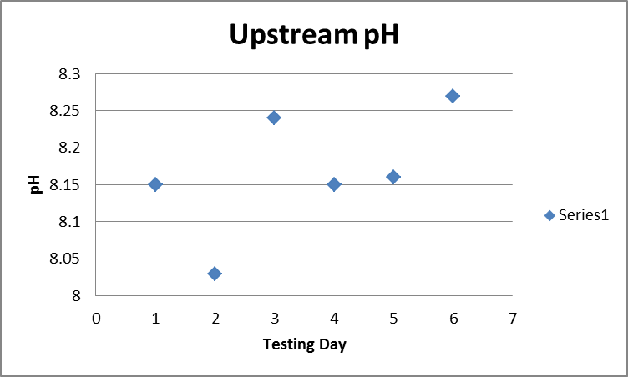
8.15
8.03
8.24
8.15
8.16
8.27
Average 8.166667
Upstream pH

Slide 40
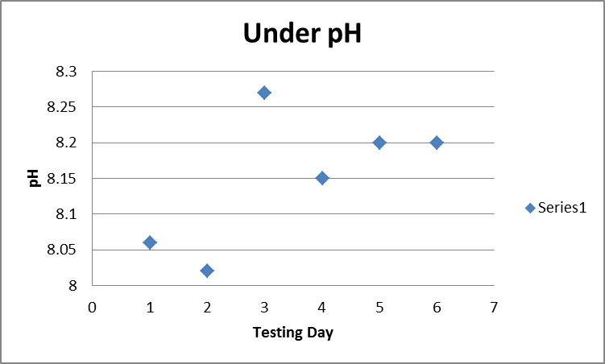
Under Overpass pH
8.06
8.02
8.27
8.15
8.2
8.2
Average 8.15

Slide 41
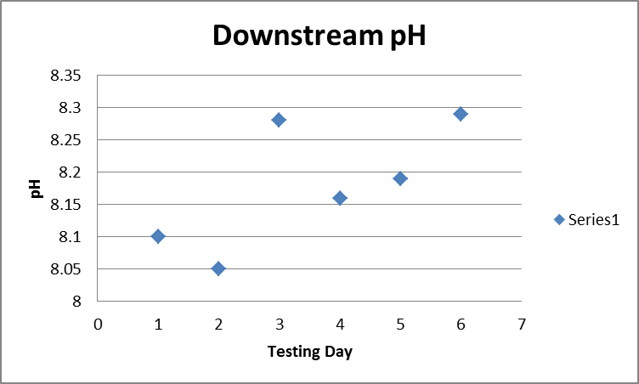
Downstream pH
8.1
8.05
8.28
8.16
8.19
8.29
Average 8.178333

Slide 42
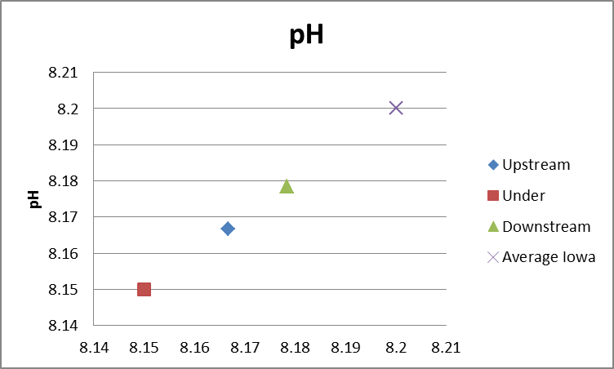
Site Comparison
Upstream 8.166666667
Under 8.15
Downstream 8.1783333
Average Iowa 8.2

Slide 43
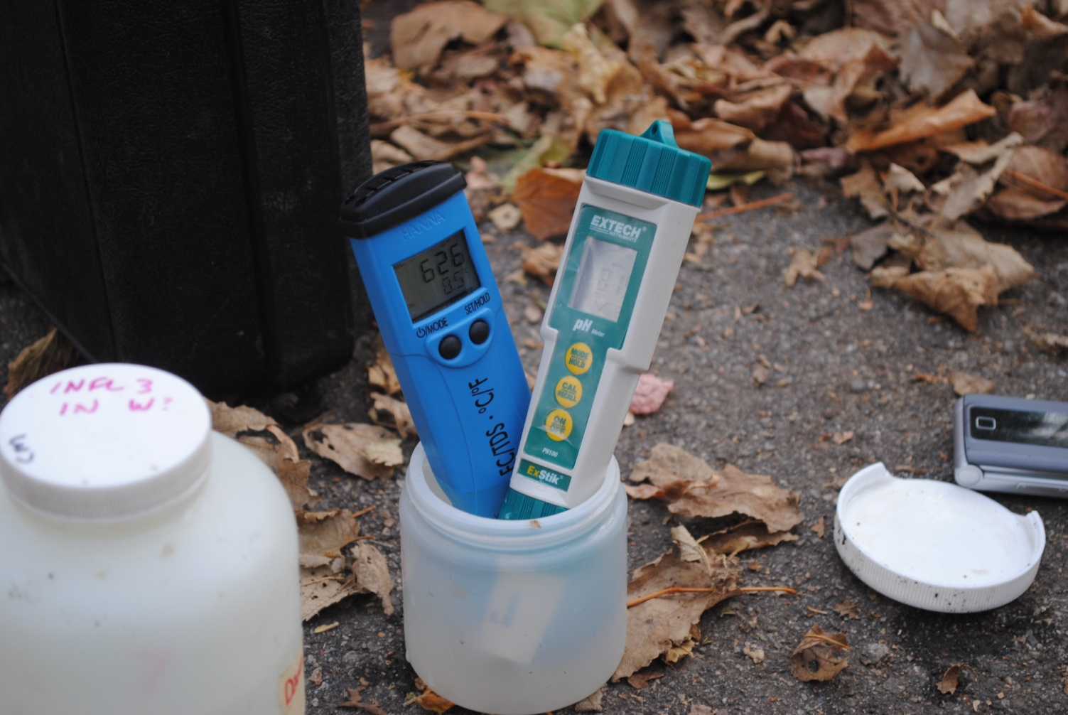
Total Dissolved Solids

Slide 44
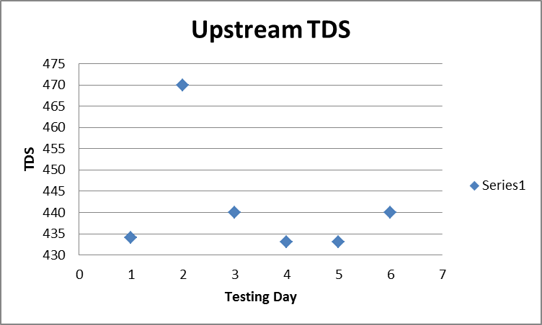
Upstream TDS
434 ppm
470 ppm
440 ppm
433 ppm
433 ppm
440 ppm
Average 441.6667 ppm

Slide 45
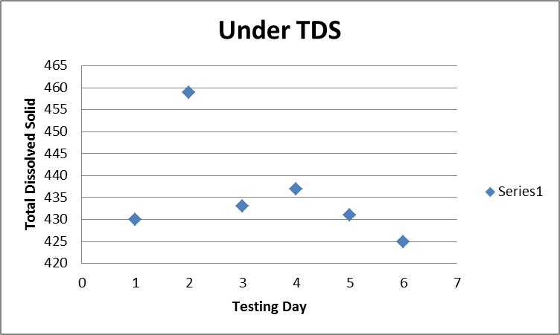
Under Overpass TDS
430 ppm
459 ppm
433 ppm
437 ppm
431 ppm
425 ppm
Average 435.8333 ppm

Slide 46
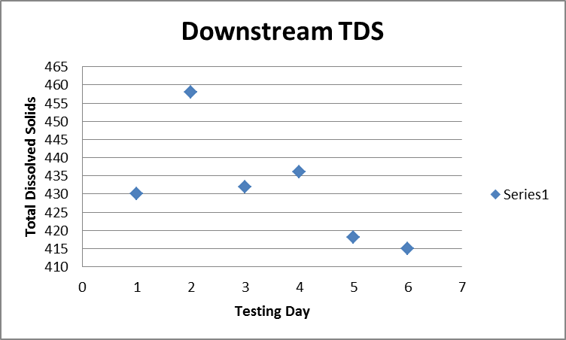
430 ppm
458 ppm
432 ppm
436 ppm
418 ppm
415 ppm
Average 431.5 ppm
Downstream TDS

Slide 47
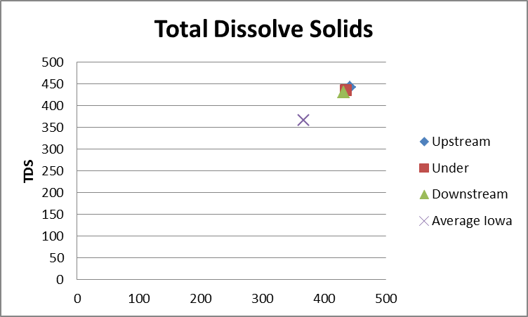
Site Comparison
Upstream 441.6666667 ppm
Under 435.8333333 ppm
Downstream 431.5 ppm
Average Iowa 367 ppm

Slide 48
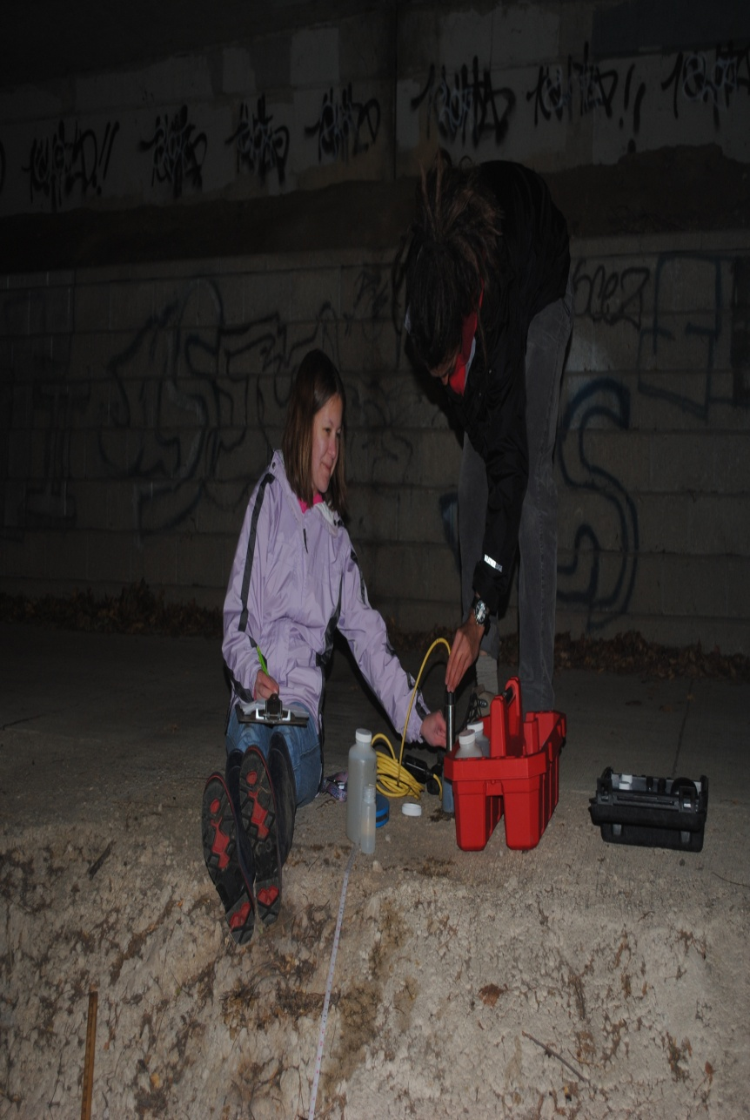
Dissolved Oxygen

Slide 49
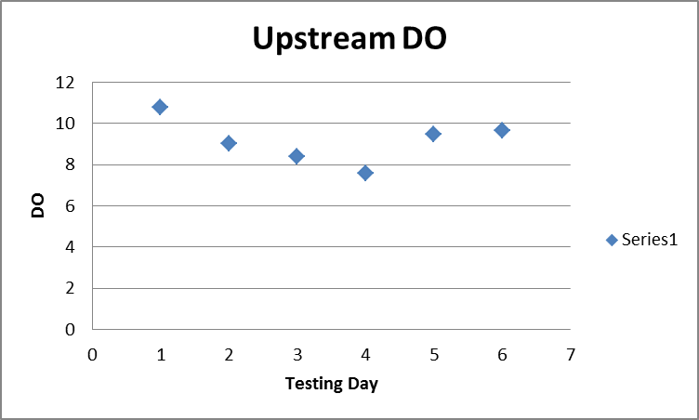
Upstream DO
10.8 mg/L
9.05 mg/L
8.39 mg/L
7.6 mg/L
9.47 mg/L
9.68 mg/L
Average 9.165 mg/L

Slide 50
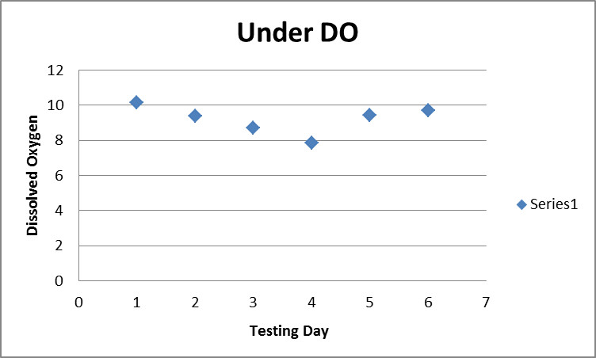
10.15 mg/L
9.39 mg/L
8.7 mg/L
7.87 mg/L
9.45 mg/L
9.69 mg/L
Average 9.208333 mg/L
Under Overpass DO

Slide 51
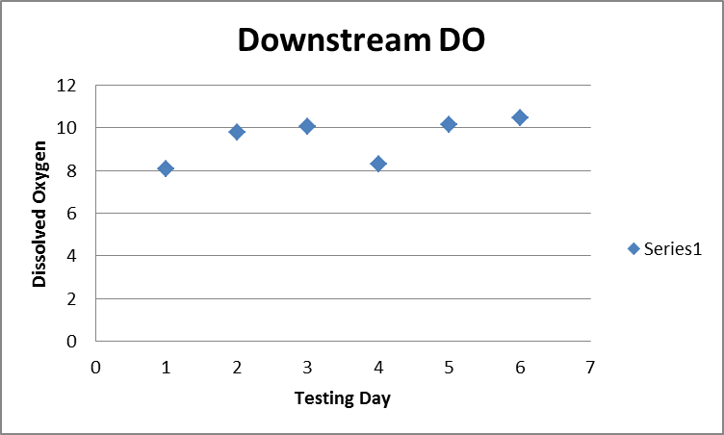
Downstream DO
8.06 mg/L
9.79 mg/L
10.06 mg/L
8.29 mg/L
10.16 mg/L
10.47 mg/L
Average 9.471667 mg/L

Slide 52
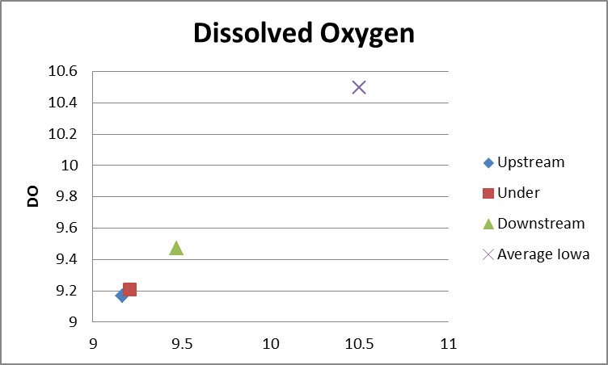
Site Comparison
Upstream 9.165 mg/L
Under 9.208333333 mg/L
Downstream 9.471666667 mg/L
Average Iowa 10.5 mg/L

Slide 53
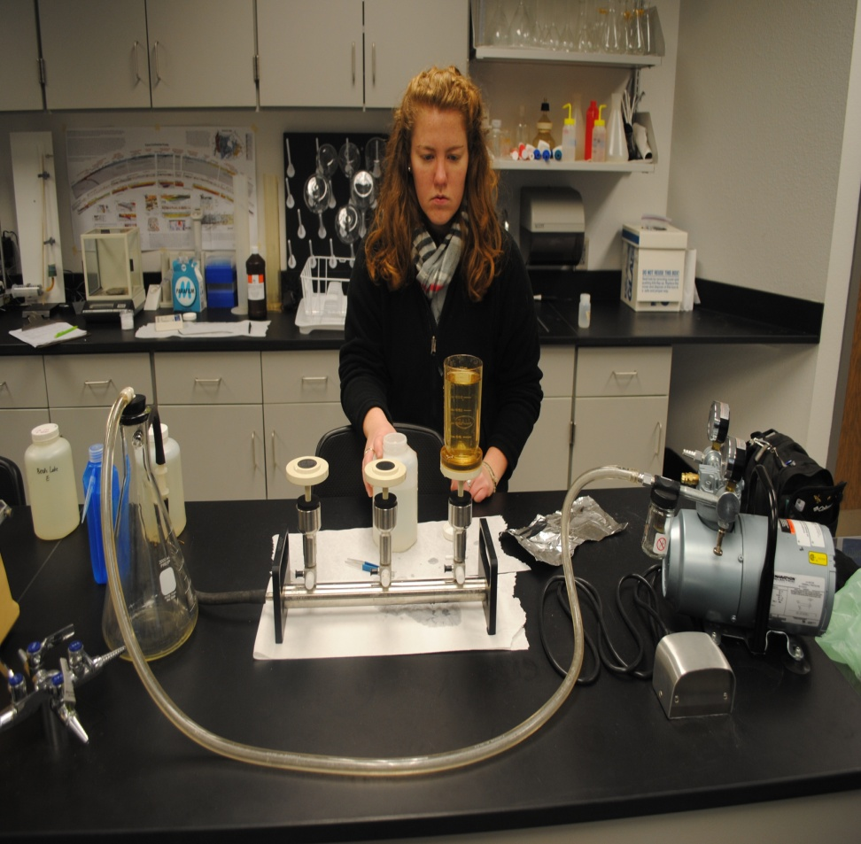
Total Suspended Solid

Slide 54
Upstream TSS
2.333333 mg/L
5.166667 mg/L
12.5 mg/L
15.3333 mg/L
9.166667 mg/L
5.166667 mg/L
Average 8.277772 mg/L

Slide 55
1.666667 mg/L
3.33333 mg/L
14.66667 mg/L
4.666667 mg/L
7.83333 mg/L
3.66667 mg/L
Average 5.972222 mg/L
Under Overpass TSS

Slide 56
Downstream TSS
5.16667 mg/L
3 mg/L
6 mg/L
4.6667 mg/L
2.166667 mg/L
3.5 mg/L
Average 4.08334 mg/L

Slide 57
Site Comparison
Upstream 8.27772 mg/L
Under 5.97222 mg/L
Downstream 4.0833395 mg/L
Average Iowa 20 mg/L

Slide 58
Storm Drain Impact

Slide 60
Turbidity
Average
Upstream 4.325 NTU
Under 2.31 NTU
Downstream 2.816666667 NTU
Drain 0.47 NTU
Average Iowa 14 NTU

Slide 61
Chloride
Averages
Upstream 1.491666667 or 36 ppm
Under 1.45 or 36 ppm
Downstream 1.415 or 33 ppm
Drain 2.05 or 52 ppm
Average Iowa 1 or 22 ppm

Slide 62
Temperature
Averages
Upstream 9.45 °C
Under 9.083333333 °C
Downstream 8.966666667 °C
Drain 13.725 °C
Average Iowa 11 °C

Slide 63
pH
Averages
Upstream 8.166666667
Under 8.15
Downstream 8.1783333
Drain 8.2525
Average Iowa 8.2

Slide 64
Total Dissolved Solid
Averages
Upstream 441.6666667 ppm
Under 435.8333333 ppm
Downstream 431.5 ppm
Drain 478.75 ppm
Average Iowa 367 ppm

Slide 65
Dissolved Oxygen
Averages
Upstream 9.165 mg/L
Under 9.208333333 mg/L
Downstream 9.471666667 mg/L
Drain 9.6925 mg/L
Average Iowa 10.5 mg/L

Slide 66
Total Suspended Solid
Averages
Upstream 8.27772 mg/L
Under 5.97222 mg/L
Downstream 4.0833395 mg/L
Drain 1.666666667 mg/L
Average Iowa 20 mg/L

Slide 67
Conclusion
Velocity increased.
Discharge decreased.
Turbidity decreased.
Chloride unaffected.
Temperature decreased.
PH unaffected.
Total dissolved solids unaffected.
Dissolved oxygen increased.
Total suspended solid decreased.

